Slide 1
21CSC201 J - Data Structures and Algorithms
Unit -III - PRIORITY QUEUE

Slide 2

Definition
A priority queue is an abstract data type that behaves similarly to the normal queue except that each element has some priority, i.e., the element with the highest priority would come first in a priority queue.
The priority of the elements in a priority queue will determine the order in which elements are removed from the priority queue.
The priority queue supports only comparable elements, which means that the elements are either arranged in an ascending or descending order.
For example, suppose we have some values like 1, 3, 4, 8, 14, 22 inserted in a priority queue with an ordering imposed on the values is from least to the greatest.
Therefore, the 1 number would be having the highest priority while 22 will be having the lowest priority.

Slide 3
Characteristics of priority queue
Every element in a priority queue has some priority associated with it.
An element with the higher priority will be deleted before the deletion of the lesser priority.
If two elements in a priority queue have the same priority, they will be arranged using the FIFO principle.

Slide 4
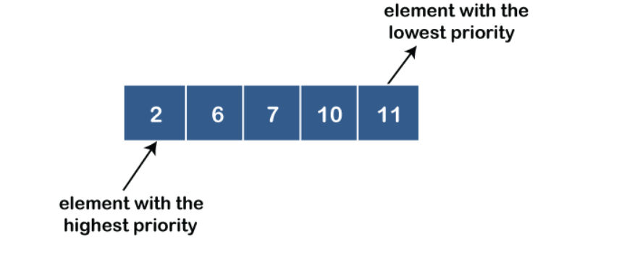
Types of priority Queue
There are two types of priority queue:
Ascending order priority queue: In ascending order priority queue, a lower priority number is given as a higher priority in a priority.
For example, we take the numbers from 1 to 5 arranged in an ascending order like 1,2,3,4,5; therefore, the smallest number, i.e., 1 is given as the highest priority in a priority queue.

Slide 5
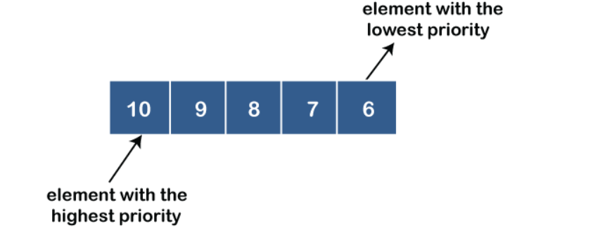
Descending order priority queue: In descending order priority queue, a higher priority number is given as a higher priority in a priority.
For example, we take the numbers from 1 to 5 arranged in descending order like 5, 4, 3, 2, 1; therefore, the largest number, i.e., 5 is given as the highest priority in a priority queue.

Slide 6
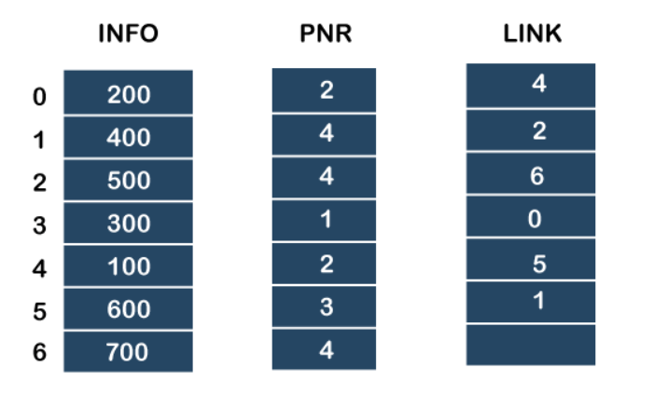
Representation of priority queue
Now, we will see how to represent the priority queue through a one-way list.
We will create the priority queue by using the list given below in which INFO list contains the data elements, PRN list contains the priority numbers of each data element available in the INFO list, and LINK basically contains the address of the next node.

Slide 7
Step by step procedure
In the case of priority queue, lower priority number is considered the higher priority, i.e., lower priority number = higher priority.
Step 1: In the list, lower priority number is 1, whose data value is 333, so it will be inserted in the list as shown in the below diagram:
Step 2: After inserting 333, priority number 2 is having a higher priority, and data values associated with this priority are 222 and 111. So, this data will be inserted based on the FIFO principle; therefore 222 will be added first and then 111.
Step 3: After inserting the elements of priority 2, the next higher priority number is 4 and data elements associated with 4 priority numbers are 444, 555, 777. In this case, elements would be inserted based on the FIFO principle; therefore, 444 will be added first, then 555, and then 777.
Step 4: After inserting the elements of priority 4, the next higher priority number is 5, and the value associated with priority 5 is 666, so it will be inserted at the end of the queue.

Slide 8
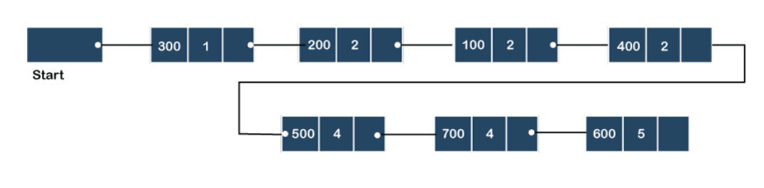

Slide 9
Implementation of Priority Queue
The priority queue can be implemented in four ways that include arrays, linked list, heap data structure and binary search tree.
The heap data structure is the most efficient way of implementing the priority queue, so we will implement the priority queue using a heap data structure in this topic.
Now, first we understand the reason why heap is the most efficient way among all the other data structures.

Slide 10
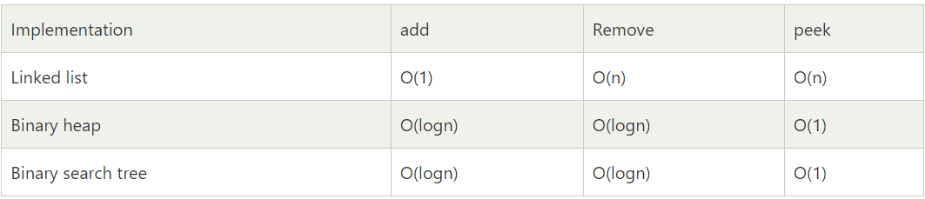
Analysis of complexities using different implementations

Slide 11
What is Heap?
A heap is a tree-based data structure that forms a complete binary tree, and satisfies the heap property.
If A is a parent node of B, then A is ordered with respect to the node B for all nodes A and B in a heap.
It means that the value of the parent node could be more than or equal to the value of the child node, or the value of the parent node could be less than or equal to the value of the child node.
Therefore, we can say that there are two types of heaps:
Max heap: The max heap is a heap in which the value of the parent node is greater than the value of the child nodes.
Min heap: The min heap is a heap in which the value of the parent node is less than the value of the child nodes.

Slide 12
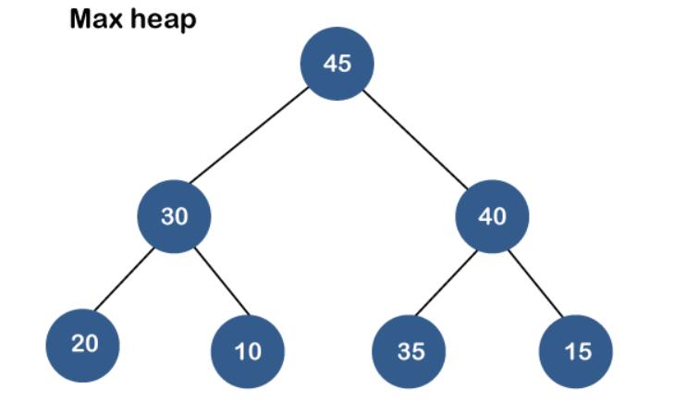
Maxheap

Slide 13
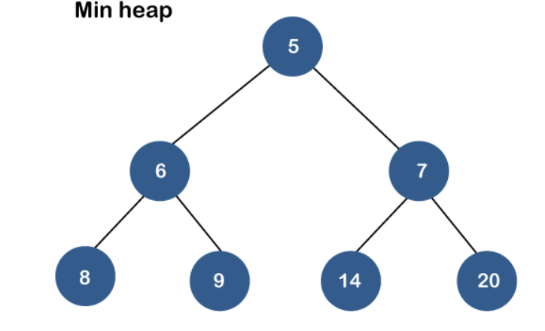
Minheap

Slide 14
Priority Queue Operations
The common operations that we can perform on a priority queue are insertion, deletion and peek. Let's see how we can maintain the heap data structure.
Inserting the element in a priority queue (max heap)
If we insert an element in a priority queue, it will move to the empty slot by looking from top to bottom and left to right.
If the element is not in a correct place then it is compared with the parent node; if it is found out of order, elements are swapped. This process continues until the element is placed in a correct position.

Slide 15
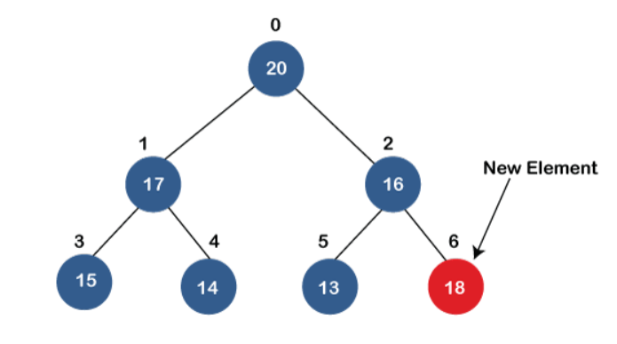
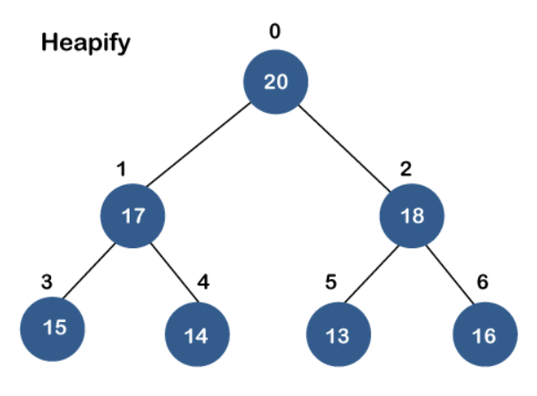

Slide 16
Removing the minimum element from the priority queue
As we know that in a max heap, the maximum element is the root node.
When we remove the root node, it creates an empty slot. The last inserted element will be added in this empty slot.
Then, this element is compared with the child nodes, i.e., left-child and right child, and swap with the smaller of the two.
It keeps moving down the tree until the heap property is restored.

Slide 17
Applications of Priority queue
It is used in the Dijkstra's shortest path algorithm.
It is used in prim's algorithm
It is used in data compression techniques like Huffman code.
It is used in heap sort.
It is also used in operating system like priority scheduling, load balancing and interrupt handling.

Slide 18
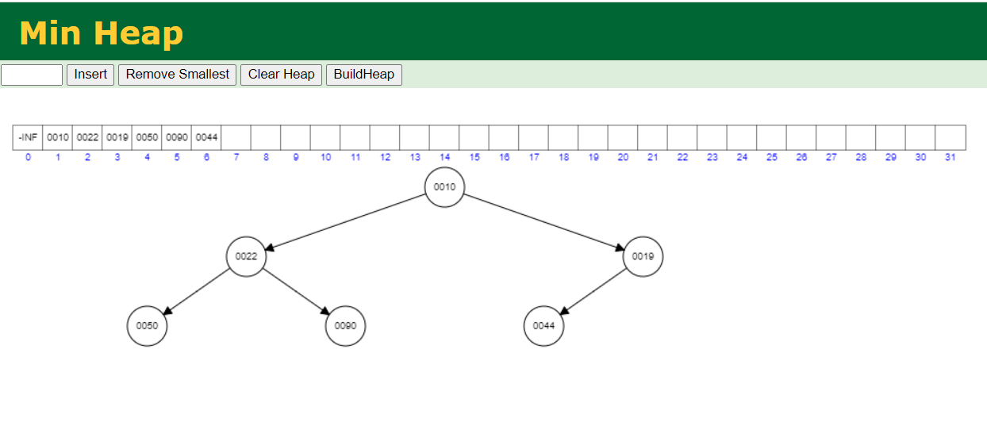
Min Heap - Example

Slide 19
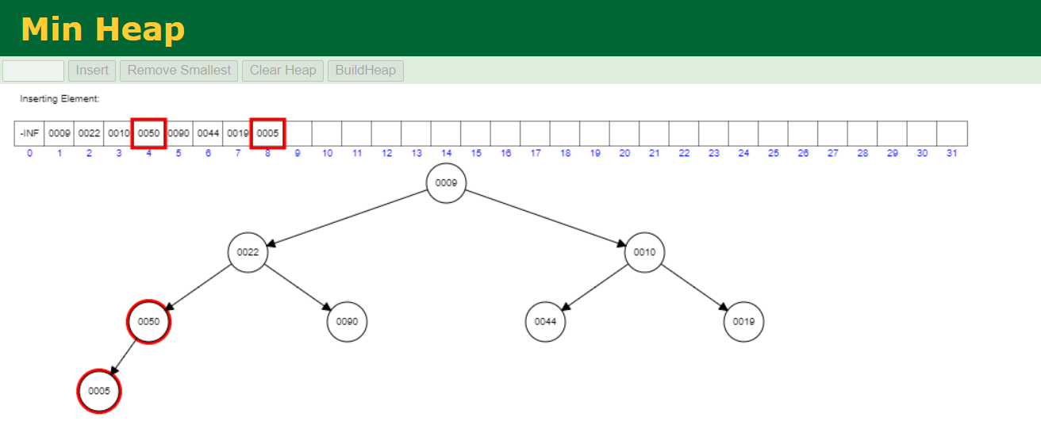
Insert the value 5

Slide 20
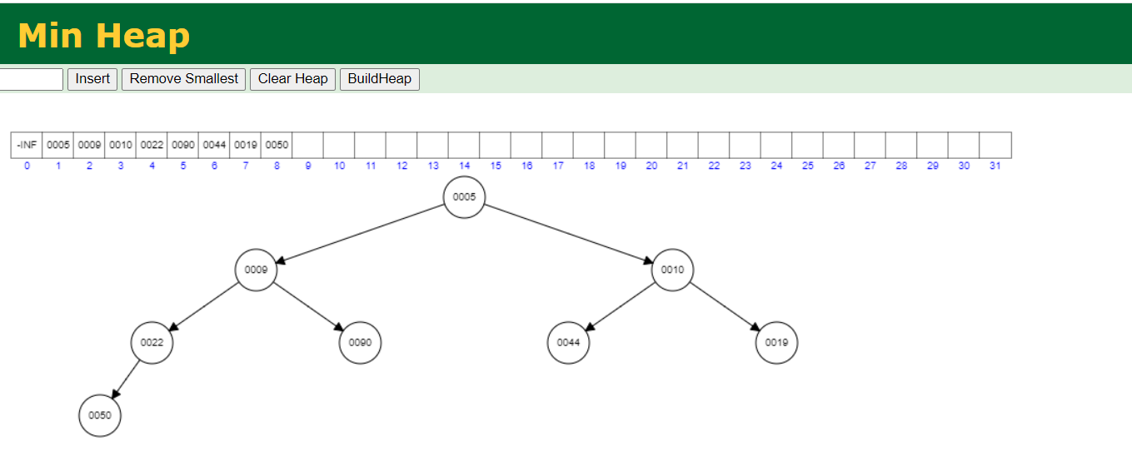

Slide 21
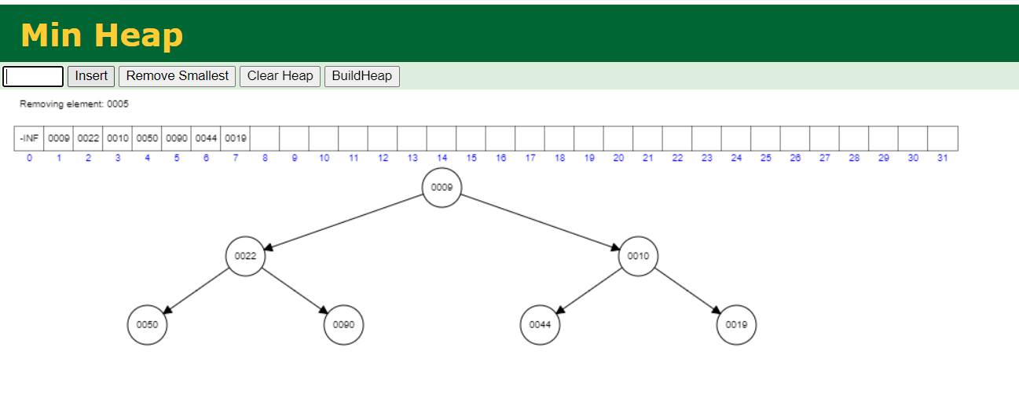
Delete ‘5’

Slide 22
Program
#include <stdio.h>
#include <stdio.h>
int heap[40];
int size=-1;
// retrieving the parent node of the child node
int parent(int i)
{
return (i - 1) / 2;
}
// retrieving the left child of the parent node.
int left_child(int i)
{
return i+1;
}

Slide 23
Program
// retrieving the right child of the parent
int right_child(int i)
{
return i+2;
}
// Returning the element having the highest priority
int get_Max()
{
return heap[0];
}
//Returning the element having the minimum priority
int get_Min()
{
return heap[size];
}

Slide 24
// function to move the node up the tree in order to restore the heap property.
void moveUp(int i)
{
while (i > 0)
{
// swapping parent node with a child node
if(heap[parent(i)] < heap[i]) {
int temp;
temp=heap[parent(i)];
heap[parent(i)]=heap[i];
heap[i]=temp;
}
// updating the value of i to i/2
i=i/2;
}
}

Slide 25
//function to move the node down the tree in order to restore the heap property.
void moveDown(int k)
{
int index = k;
// getting the location of the Left Child
int left = left_child(k);
if (left <= size && heap[left] > heap[index]) {
index = left;
}
// getting the location of the Right Child
int right = right_child(k);
if (right <= size && heap[right] > heap[index]) {
index = right;
}
// If k is not equal to index
if (k != index) {
int temp;
temp=heap[index];
heap[index]=heap[k];
heap[k]=temp;
moveDown(index);
}
}

Slide 26
// Removing the element of maximum priority
void removeMax()
{
int r= heap[0];
heap[0]=heap[size];
size=size-1;
moveDown(0);
}
//inserting the element in a priority queue
void insert(int p)
{
size = size + 1;
heap[size] = p;
// move Up to maintain heap property
moveUp(size);
}

Slide 27
//Removing the element from the priority queue at a given index i.
void delete(int i)
{
heap[i] = heap[0] + 1;
// move the node stored at ith location is shifted to the root node
moveUp(i);
// Removing the node having maximum priority
removeMax();
}
int main()
{
// Inserting the elements in a priority queue
insert(20);
insert(19);
insert(21);
insert(18);
insert(12);
insert(17);
insert(15);
insert(16);
insert(14);
int i=0;

Slide 28
printf("Elements in a priority queue are : ");
for(int i=0;i<=size;i++)
{
printf("%d ",heap[i]);
}
delete(2); // deleting the element whose index is 2.
printf("\nElements in a priority queue after deleting the element are : ");
for(int i=0;i<=size;i++)
{
printf("%d ",heap[i]);
}
int max=get_Max();
printf("\nThe element which is having the highest priority is %d: ",max);
int min=get_Min();
printf("\nThe element which is having the minimum priority is : %d",min);
return 0;
}

Slide 29
int parent(int i): This function returns the index of the parent node of a child node, i.e., i.
int left_child(int i): This function returns the index of the left child of a given index, i.e., i.
int right_child(int i): This function returns the index of the right child of a given index, i.e., i.
void moveUp(int i): This function will keep moving the node up the tree until the heap property is restored.
void moveDown(int i): This function will keep moving the node down the tree until the heap property is restored.
void removeMax(): This function removes the element which is having the highest priority.
void insert(int p): It inserts the element in a priority queue which is passed as an argument in a function.
void delete(int i): It deletes the element from a priority queue at a given index.
int get_Max(): It returns the element which is having the highest priority, and we know that in max heap, the root node contains the element which has the largest value, and highest priority.
int get_Min(): It returns the element which is having the minimum priority, and we know that in max heap, the last node contains the element which has the smallest value, and lowest priority.

Slide 30
